Slide 1
GRADUATION PROJECT · BIG DATA ENGINEERING · 2026
Egypt E-Commerce
Big Data Personalization Pipeline
End-to-end batch + real-time architecture with Kafka, Spark, PostgreSQL, Streamlit & Power BI
Presented by
9
~360K
3s / 5s
[ Your Name ]
[ Your University · Department ]
silver tables
integrated
rows processed
in batch
dashboard refresh /
stream micro-batch
May 2026

Slide 2


Slide 3
Agenda
02 / 16
What we will cover in the next 15 minutes
01
Problem Statement & Objectives
02
System Architecture
Why this project, who benefits
Batch + streaming overview
03
Technology Stack
04
Batch ETL Phase
Tools and versions
Silver layer cleaning & warehousing
05
Streaming ETL Phase
06
Visualization Layer
Real-time event pipeline
Streamlit dashboard + Power BI
07
Azure Cloud Integration
08
Results, Challenges & Future Work
Path to managed services
What we learned, what's next
Egypt E-Commerce Big Data Personalization Pipeline · Graduation Project 2026
EGYPT-ECOMM-PERS-V3.1

Slide 4
Problem Statement
03 / 16
The gap this project addresses
Why Egypt E-Commerce?
Our Approach
Egypt's e-commerce market is growing rapidly, yet most analytics platforms are built around USD pricing and Western shipping zones. Local merchants need Arabic-aware, EGP-localized, governorate-level insights — in both historical and live form.
Localized data
All money in EGP, Arabic + English categories, governorate-level joins
Two-speed analytics
Hours-old batch warehouse + sub-second streaming dashboard
Historical analytics in EGP per governorate are scarce
Real-time order monitoring is dominated by expensive SaaS
Free-tier first
Schema drift between Arabic / English categories is unaddressed
Local Docker stack costs $0; cloud add-ons opt-in per use case
Most graduation projects stop at batch — streaming is uncommon
Reproducible
Docker Compose + Airflow DAGs + checked-in SQL = clone-and-run
Egypt E-Commerce Big Data Personalization Pipeline · Graduation Project 2026
EGYPT-ECOMM-PERS-V3.1

Slide 5
Project Objectives
04 / 16
Concrete deliverables we set out to build
100%
<8 s
0 $
2
Coverage of the
ORIGINAL silver layer
End-to-end
streaming latency
Local infrastructure
running cost
Dashboard surfaces
(dev + enterprise)
9 of 9 tables migrated, audited, and saved as Parquet + Postgres
Producer → Kafka → Spark → Postgres → Streamlit
Everything runs in Docker on a laptop; cloud add-ons are optional
Streamlit for engineers + Power BI for business users
Egypt E-Commerce Big Data Personalization Pipeline · Graduation Project 2026
EGYPT-ECOMM-PERS-V3.1

Slide 6
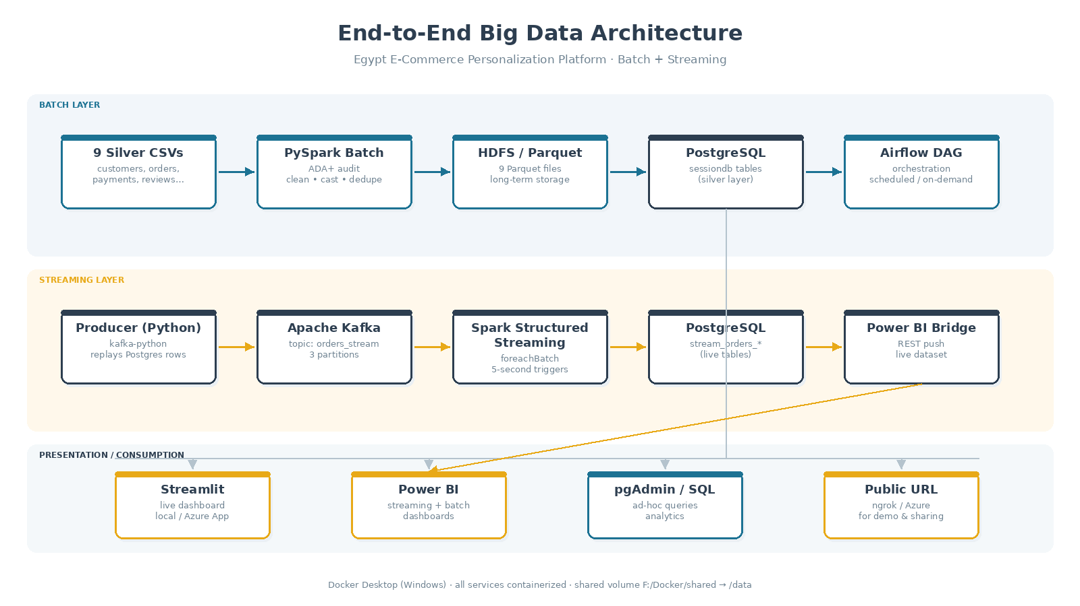
System Architecture
05 / 16
Three layers: batch ingestion, real-time streaming, and presentation
Both batch and streaming paths converge on PostgreSQL — the single source of truth that powers every dashboard.
Egypt E-Commerce Big Data Personalization Pipeline · Graduation Project 2026
EGYPT-ECOMM-PERS-V3.1

Slide 7
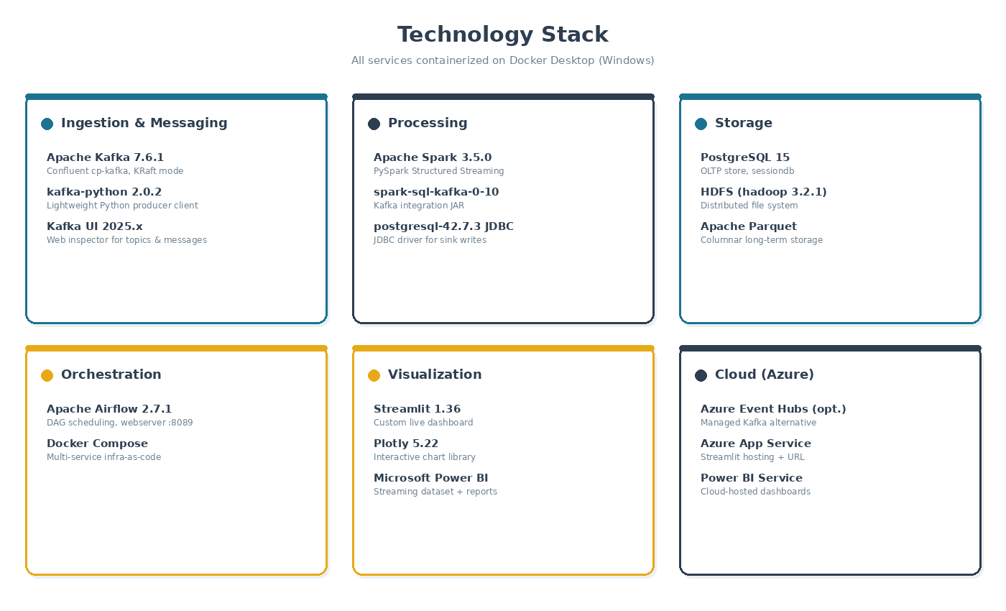
Technology Stack
06 / 16
Six categories — every component containerized for reproducibility
Egypt E-Commerce Big Data Personalization Pipeline · Graduation Project 2026
EGYPT-ECOMM-PERS-V3.1

Slide 9
Pipeline Architecture
ARCHITECTURE
Source
Bronze
Silver
Gold
Dashboards
9 CSV Files
~550K rows
→
Raw Parquet
HDFS
→
Cleaned Parquet
HDFS
→
Star Schema
PostgreSQL
→
Power BI
6 Pages
Orchestrated by Apache Airflow — DAG: olist_batch_pipeline (bronze → silver → gold_delivery → gold_churn)
Infrastructure Components
12 Docker Containers
Spark Standalone Cluster
HDFS (NameNode + DataNode)
PostgreSQL (sessiondb)
Airflow (Webserver + Scheduler)
pgAdmin | Kafka UI | Jupyter

Slide 10
Bronze & Silver Layers
DATA LAYERS
🥉 BRONZE LAYER — Raw Ingestion
🥈 SILVER LAYER — Cleaned Data
What Bronze Does
Orders
Cast 5 timestamp columns; null 1,359 chronological violations
Reads 9 CSV files from shared volume using file:// prefix
Writes each as snappy-compressed Parquet to HDFS
Zero transformations — exact landing copy
file:// prefix required: defaultFS=hdfs, so local files need explicit scheme
Handles UTF-8 encoding preserving Arabic columns
Products
Dropped 610 null rows; fixed 2 typos; median-filled; computed volume
Translations
Added 2 missing categories via Spark SQL UNION ALL
Payments
Removed 9 zero-value rows
Reviews
Filled 87K null titles and 58K null messages
Geolocation
Removed null lat/lon; deduplicated by zip+lat+lng

Slide 11
Gold Layer — Delivery Performance Datamart
GOLD LAYER
Schema: delivery_performance | Star Schema | 2 Fact Tables + 4 Dimensions
dim_date
dim_customer
dim_seller
dim_product
800 rows
99,441 rows
3,095 rows
32,341 rows
Full date spine 2016–2018. Day, week, month, quarter, year, weekend flags.
Customer profiles with Egyptian governorate, city, lat/lon from geolocation.
Seller profiles with governorate and geolocation coordinates.
Products with category (EN), dimensions, volume, size & weight tier.
Fact Tables
fct_order_delivery
98,666 rows
fct_seller_fulfillment
112,650 rows
• delivery_duration_days, delay_days, buffer_days
• freight_value, item_price
• delivery_status (on_time/late/very_late/not_delivered)
• product_weight_g, product_volume_cm3
• on_time_flag, distance_bucket (0-50/50-200/200-500/500+km)
• seller_preparation_days, shipping_deadline_gap_days
• freight_total_value, total_items_count, seller_count
• freight_ratio (freight / item price)
• is_multi_seller_order
• heavy_product_flag, seller_to_customer_distance_km

Slide 12
Airflow Orchestration
ORCHESTRATION
DAG: olist_batch_pipeline | Schedule: @daily | 4 tasks | BashOperator
bronze ingestion
→
silver transformation
→
gold delivery performance
→
gold customer churn
~3 min
~5 min
~8 min
~8 min
⚠ Gold tasks run SEQUENTIALLY — parallel execution overloads the single Spark worker (TaskResultLost errors)
How Airflow Submits to Spark
Auto-Truncate on Every Run
Airflow scheduler has PySpark installed (same Docker network)
Uses BashOperator with explicit JAVA_HOME export
Submits spark-submit directly (not via docker exec)
JAR path: /data/jars/ (shared volume — accessible from both containers)
HDFS: Gold scripts auto-chmod 777 via WebHDFS REST API
Both Gold scripts truncate their tables at startup
Uses JDBC DriverManager TRUNCATE ... RESTART IDENTITY CASCADE
Makes every run idempotent — no manual cleanup needed
Key lesson: never use spark.createDataFrame() — causes Python 3.9 vs 3.11 mismatch
Use pure Spark SQL UNION ALL instead

Slide 13
Power BI Dashboards
VISUALIZATION
📦 DELIVERY PERFORMANCE DATAMART — 3 Pages
99K
89.9%
12 days
10 days
Total Orders
On-Time Rate
Avg Delivery
Avg Delay
Page 1: Overview
Page 2: Deep Dive
Page 3: Fulfillment
4 KPI cards
Donut: delivery status
Bar: on-time by region
Line/column: monthly trends
Bar: distance vs delivery
Top 10 categories by freight
Map: customer locations
Bar: delay by seller region
Bar: delay by customer region
Bar: on-time by year & quarter
Column: delivery by distance
4 KPI cards
Top 10 sellers by freight
Donut: weight categories
Bar: freight ratio by category
Bar: prep days by seller region
Scatter: distance vs freight
👥 CUSTOMER CHURN DATAMART — 3 Pages
96K
96.9%
975
2.1%
Unique Customers
One-Time Buyers
Loyal Customers
Churn Rate

Slide 14
Key Business Insights
INSIGHTS
📦 Delivery Performance
👥 Customer Churn
89.9%
On-time delivery rate overall
96.88%
Customers purchased only once — extreme problem
2016→2018
On-time improved 75% → 95% — rapid maturity
975
Loyal customers out of 96,096 total — only 1%
~50 days
New Valley avg delay when late (most remote)
2.1x
Loyal customers spend more (3,200 vs 1,500 EGP)
~20 days
Suez sellers cause highest delays
57 vs 129
Churned vs Loyal days between orders
93.4%
home_comfort_2 freight ratio — anomaly
5.2%
North Sinai highest churn rate
8.5 days
Monufia sellers slowest preparation time
57M EGP
Cairo total revenue — highest retention ROI

Slide 15
Technical Challenges & Solutions
LESSONS
HDFS Permission Failures
Python Version Mismatch
PROBLEM
Different users (spark vs airflow) can't write to HDFS folders created by the other user
PROBLEM
Airflow runs Python 3.9; Spark workers run Python 3.11 — createDataFrame() triggers worker execution
SOLUTION
Both Gold scripts call WebHDFS REST API (curl) at startup to chmod 777 all gold directories
SOLUTION
Replace all spark.createDataFrame() calls with pure Spark SQL UNION ALL — no Python worker needed
JAR Not Found from Airflow
Parallel Gold Tasks Crash
PROBLEM
/opt/spark/jars/postgresql-42.7.3.jar exists on Spark container, not on Airflow container
PROBLEM
Both Gold tasks running simultaneously overload the single Spark worker → TaskResultLost errors
SOLUTION
Copy JAR to shared volume at /data/jars/ — accessible from all containers via mount
SOLUTION
Change DAG from parallel to sequential: gold_delivery >> gold_churn

Slide 16
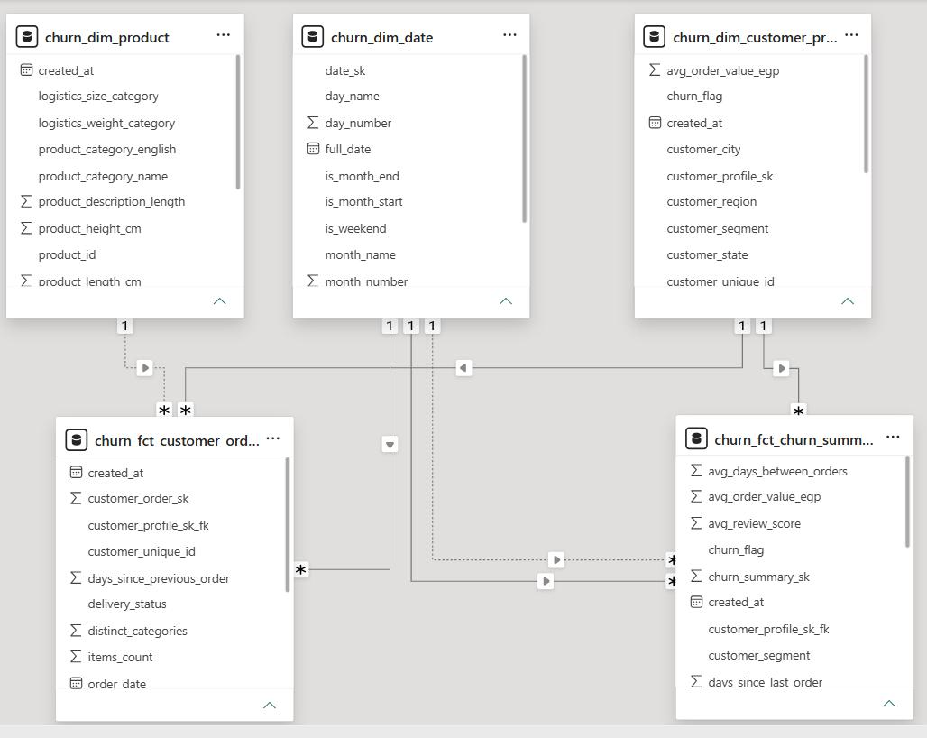

Slide 17
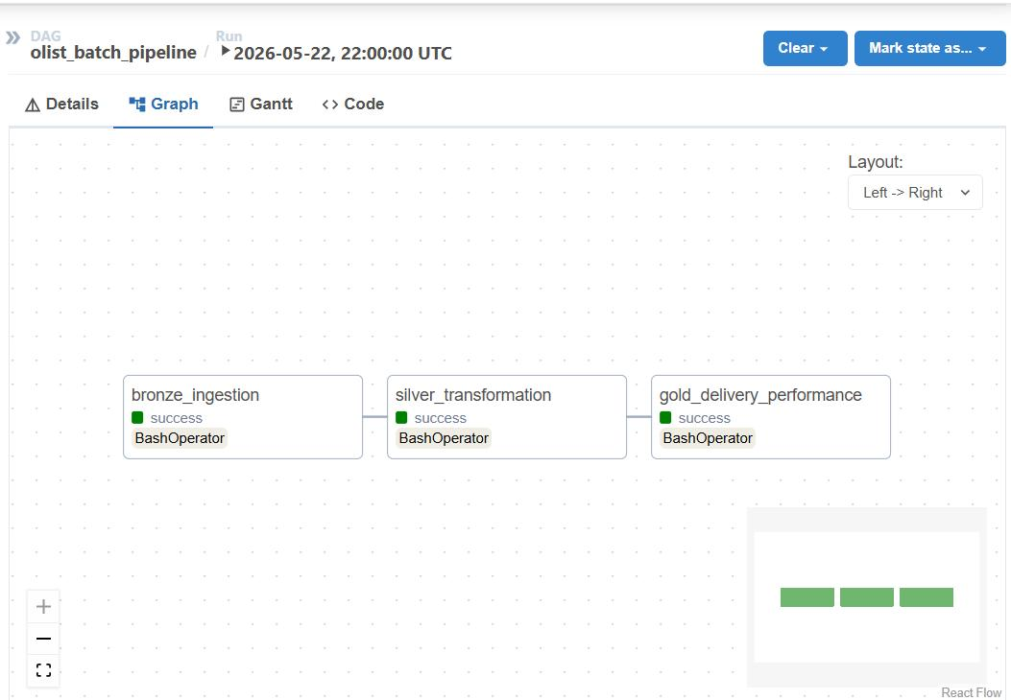

Slide 18
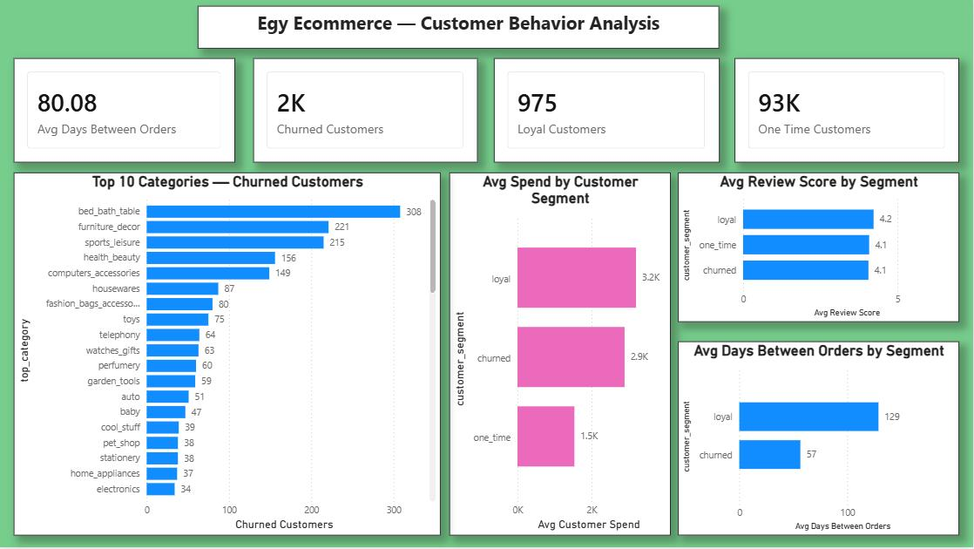

Slide 19
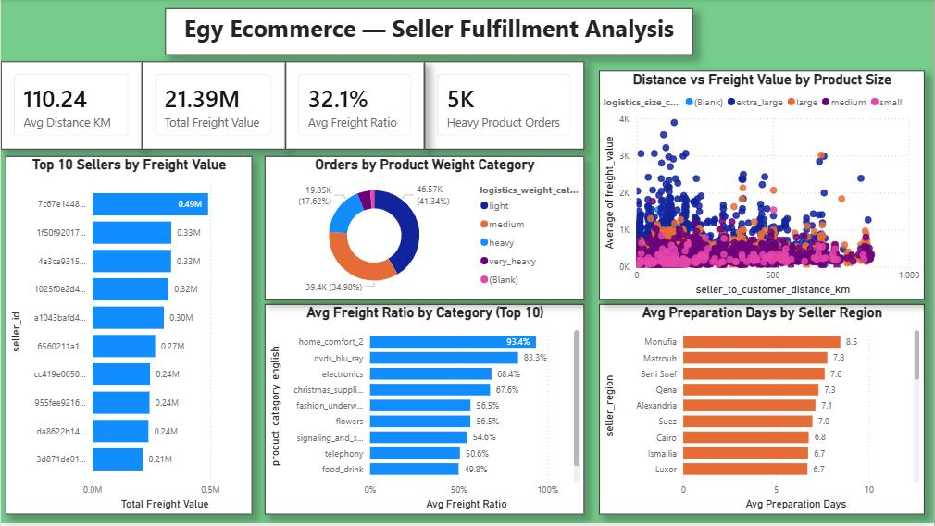

Slide 20
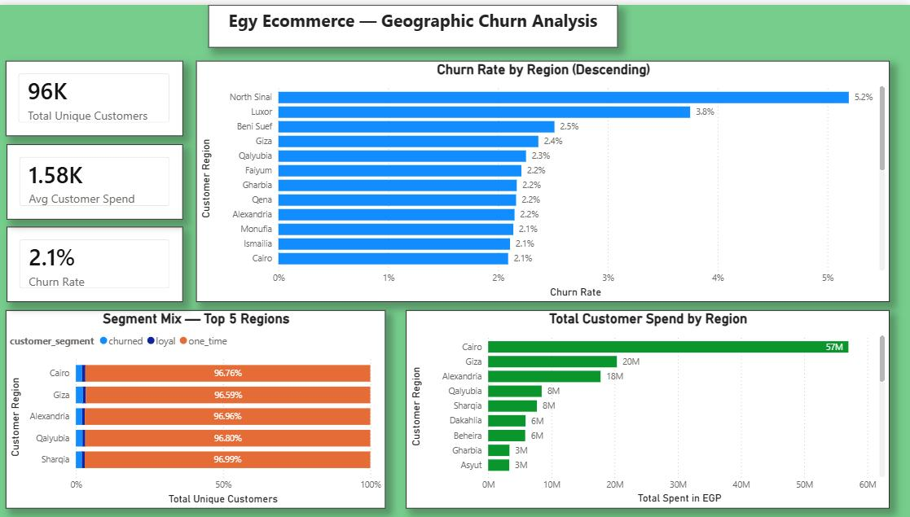

Slide 22
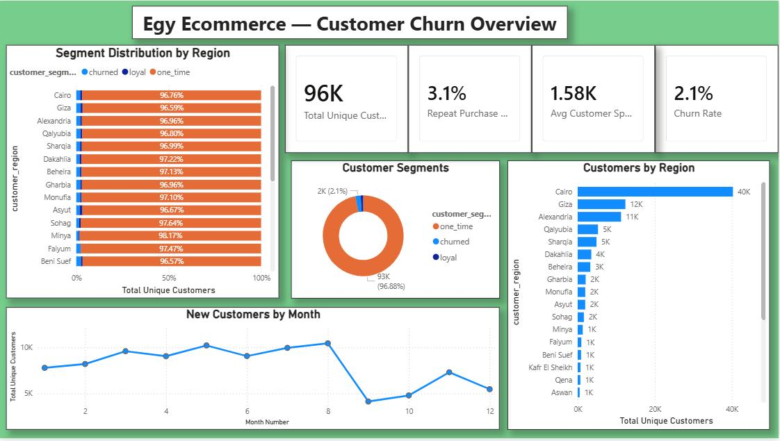

Slide 23
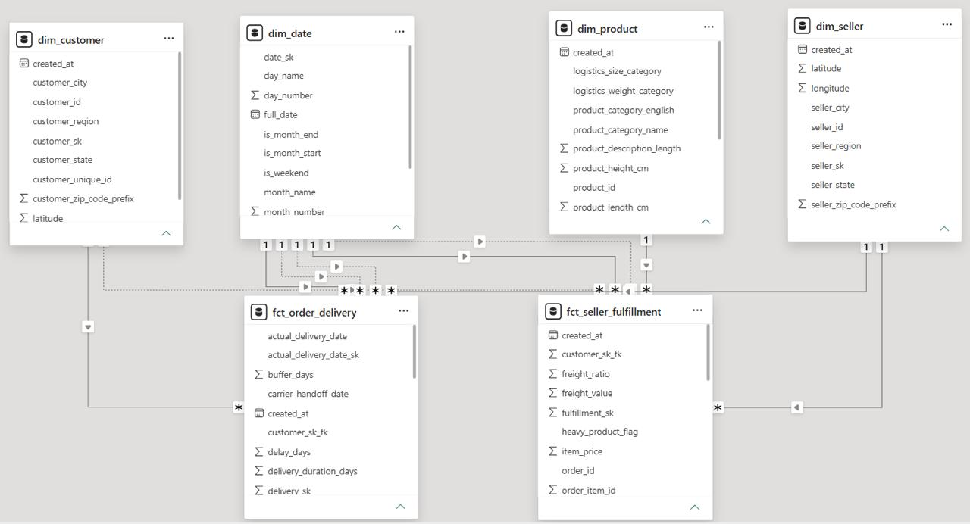

Slide 24
Batch ETL Phase
07 / 16
One-shot processing of historical silver-layer data
Pipeline Stages
1.
Read 9 CSVs
from /data/silver_csv/
2.
ADA+ Audit
null & duplicate detection
3.
Clean & cast
timestamps, integers, EGP
4.
Persist
Parquet + PostgreSQL
5.
Export
clean CSVs for sharing
Egypt E-Commerce Big Data Personalization Pipeline · Graduation Project 2026
EGYPT-ECOMM-PERS-V3.1

Slide 25
Batch Phase — Data Validation
08 / 16
Row counts after cleaning, invalid rows removed
Table
Rows after cleaning
Notes
Cleaning Actions Performed
customers
99,441
joined with governorate
Null detection
orders
99,441
5 date cols cast to timestamp
Counted nulls across every column; removed rows missing critical IDs
order_items
112,650
EGP price + freight
Duplicate scan
payments
103,886
installments cast to int
Dropped exact duplicate order_ids and review_ids
reviews
100,789
3,373 invalid rows removed
products
32,951
category + dimensions
Type casting
5 timestamp columns string → timestamp; review_score string → int
sellers
3,095
governorate joined
geolocation
9,637
Egypt-localized coordinates
Currency
category
74
Arabic + English mapping
All money fields → EGP localized (price_egp, freight_value_egp, …)
Schema enforcement
Strict types written to Parquet + Postgres for downstream safety
Egypt E-Commerce Big Data Personalization Pipeline · Graduation Project 2026
EGYPT-ECOMM-PERS-V3.1

Slide 26
Streaming ETL Phase
09 / 16
Continuous event flow — sub-10 second end-to-end latency
Streaming Components
Producer
kafka-python
replays real orders
from Postgres
Kafka
cp-kafka 7.6
3-partition topic
orders_stream
Spark
Structured
5s micro-batches
foreachBatch sink
PostgreSQL
JDBC writes
raw + gov + status
rolling tables
Egypt E-Commerce Big Data Personalization Pipeline · Graduation Project 2026
EGYPT-ECOMM-PERS-V3.1

Slide 27
Streaming Implementation
10 / 16
Why foreachBatch + idempotent appends, not direct JDBC sink
Design Decisions
Core Sink Function (excerpt)
foreachBatch for the JDBC sink
Spark Structured Streaming has no built-in JDBC sink; foreachBatch lets us reuse the batch DataFrame API to write three sinks atomically per micro-batch.
def foreach_batch(batch_df, batch_id):
if batch_df.rdd.isEmpty(): return
batch_df.persist()
# 1) raw events
raw = batch_df.withColumn(
"batch_id", lit(batch_id))
write_jdbc(raw, "stream_orders_raw")
# 2) per-governorate rollup
gov = (batch_df.groupBy("governorate")
.agg(_count("order_id").alias("orders"),
_sum("payment_value_egp")
.alias("revenue_egp"))
.withColumn("batch_id", lit(batch_id))
.withColumn("batch_time",
current_timestamp()))
write_jdbc(gov, "stream_orders_live_gov")
batch_df.unpersist()
Checkpointing to /data/checkpoints
Survives container restarts and provides exactly-once semantics into Kafka offsets.
Key = order_id at the producer
Ensures all events for the same order land on the same partition — preserves order ordering.
Three derived tables
stream_orders_raw (audit), stream_orders_live_gov (governorate aggregates), stream_orders_live_status (status mix).
Egypt E-Commerce Big Data Personalization Pipeline · Graduation Project 2026
EGYPT-ECOMM-PERS-V3.1

Slide 28
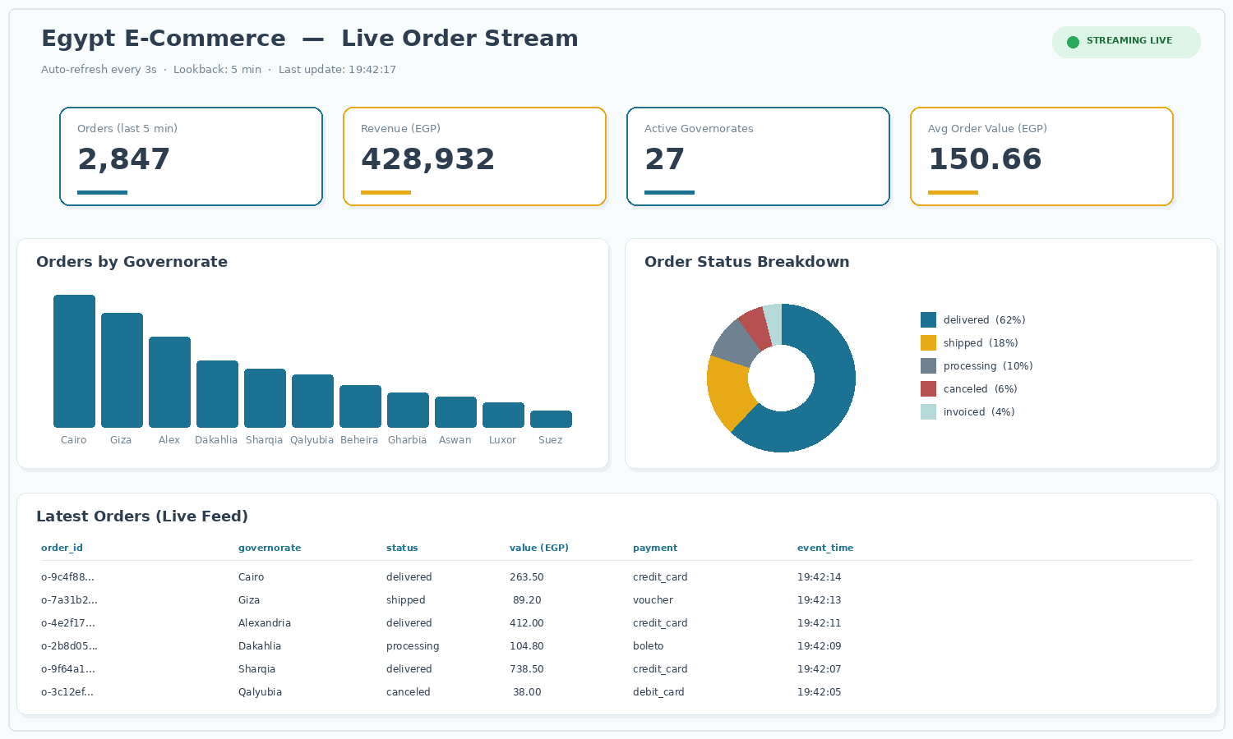
Live Dashboard — Streamlit
11 / 16
What users see: KPIs, governorate bar chart, status mix, live feed
Polls PostgreSQL every 3 seconds · charts auto-update without page reload

Slide 29
Cloud Integration
12 / 16
Power BI + Azure — enterprise-grade dashboards on top of the same Postgres backbone
Power BI
Azure App Service
Azure Event Hubs
Streaming Dataset
Streamlit hosting
Managed Kafka (optional)
Push-based, sub-second updates via REST API
Container deployment, permanent URL
Drop-in replacement using Kafka surface
Real-time visuals tile by tile
Replaces ngrok for the demo
Basic tier ~ $11 / month
Public share link inside tenant
B1 tier ~ $13 / month, covered by credit
Code change: just bootstrap_servers URL
FREE with Power BI Pro (Azure for Students)
https://egypt-ecomm.azurewebsites.net
Adds 'cloud-native' to the architecture story
Egypt E-Commerce Big Data Personalization Pipeline · Graduation Project 2026
EGYPT-ECOMM-PERS-V3.1

Slide 30
Public Deployment
13 / 16
Making the dashboard reachable from outside the laptop
A
ngrok tunnel
TIME
COST
5 min
Free
Fastest path for the defense — public URL with one command, no migrations needed.
B
Streamlit Cloud + Neon
TIME
COST
1 hour
Free
Push to GitHub, host on Streamlit Cloud, mirror Postgres to Neon free tier.
C
Azure App Service
TIME
COST
1–2 hours
$13/mo
Permanent URL like https://egypt-ecomm.azurewebsites.net — credit-covered.
Recommended path for graduation defense: A on demo day → C as the permanent submission link.

Slide 31
Results & Metrics
14 / 16
What the running system actually delivers
9 / 9
~360 K
3,373
5 s
tables migrated
rows processed
invalid rows removed
micro-batch trigger
3 s
< 8 s
3
13
dashboard refresh
end-to-end latency
live PG tables
Docker containers
Beyond the numbers
The same Postgres backbone successfully fed both Streamlit (engineering-friendly) and Power BI (business-friendly) dashboards simultaneously, with sub-10 second event latency from producer to chart — proving the dual-consumer pattern that production teams rely on.
Egypt E-Commerce Big Data Personalization Pipeline · Graduation Project 2026
EGYPT-ECOMM-PERS-V3.1

Slide 32
Challenges & Solutions
15 / 16
What broke, how we fixed it
JMX agent crash in Kafka CLI
Spark has no native JDBC sink
Confluent image bound port 1234 to a Prometheus JMX exporter for every Java process — kafka-topics CLI failed at startup with BindException.
writeStream.format("jdbc") doesn't exist — Spark Structured Streaming has no built-in sink for relational databases.
Solution: created topics via Kafka UI (port 8090); for CLI, unset KAFKA_OPTS before each command.
Solution: used foreachBatch to convert each micro-batch into a regular DataFrame and write to three tables atomically.
Pandas 2.2.2 compile failure on Python 3.13
PowerShell context resets between windows
Pre-built wheel didn't exist; pip tried to compile from C source and failed because no Visual Studio build tools.
Each new PowerShell window starts in C:\WINDOWS\System32 with no venv active, breaking pip/streamlit commands.
Solution: dropped strict version pinning, installed latest pandas which has a 3.13-compatible wheel.
Solution: documented the cd + activate ritual that must precede every command in every new terminal.
Egypt E-Commerce Big Data Personalization Pipeline · Graduation Project 2026
EGYPT-ECOMM-PERS-V3.1

Slide 33
Future Work & Conclusion
16 / 16
Where this pipeline can go next
Roadmap
Schema Registry
Thank you
Migrate JSON events to Avro with Confluent Schema Registry for safer producer/consumer contracts.
Questions, comments, and discussion welcome.
Multi-broker Kafka
Replicate the topic across 3 brokers for fault tolerance.
Personalization model
Project repository
Train a recommendation model on the silver layer and serve via streaming Spark MLlib.
github.com/<your-handle>/egypt-ecomm-bigdata
Cloud-native rebuild
Live demo
Migrate to Azure Event Hubs + Stream Analytics + Power BI streaming, all wired through Bicep IaC.
https://<ngrok-or-azure-url>
Airflow orchestration
Contact
Add a daily DAG that snapshots streaming aggregates back to the batch silver layer.
[ your.email@university.edu ]

